Slide 1
Image-to-Sentence Generation
Team
Adil Zhiyenbayev
Nurlan Kabdyshev
Rakhat Abdrakhmanov
Zarema Balgabekova

Slide 2
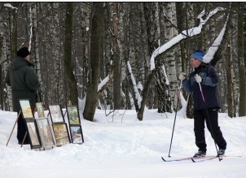
Introduction
Captioning Model
skier looks at framed pictures in the snow

Slide 3
Challenges
No accepted framework
Limited Datasets
Hard to Evaluate
Covering the whole picture
Models may not work on different pictures

Slide 4
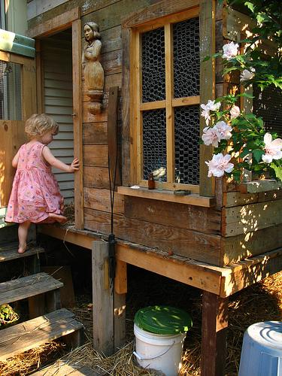
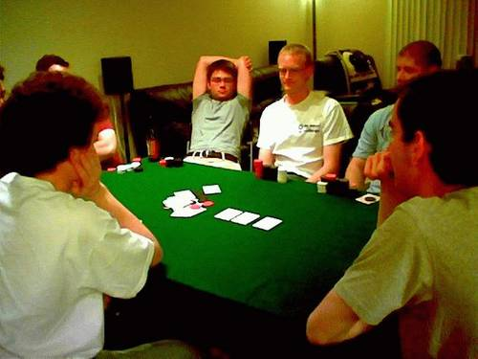
Datasets
Flickr8k
Flickr30k
A girl going into a wooden building
several men play cards while around green table

Slide 5
Related works
CNN based encoders + language models:
The activation of a CNN’s last layers is utilized to derive high- level representations, subsequently acting as a conditioning factor for the language model.
In [1], GoogleNet was used to initiate the hidden state of the language model
In [2], AlexNet was used to extract the features form img. And feed the language model
In [3], ResNet101 with FC was used as encoder, leveraging the power of convolutional layers for efficient and effective processing of image data
Limitations:
Overly compressed data
Lack of granularity
[1] O. Vinyals, A. Toshev, S. Bengio, and D. Erhan. Show and tell: A neural image caption generator. In Proceedings of the IEEE conference on computer vision and pattern recognition, pages 3156–3164, 2015.
[2] Karpathy and L. Fei-Fei. Deep visual-semantic alignments for generating image descriptions. In Proceedings of the IEEE conference on computer vision and pattern recognition, pages 3128–3137, 2015.
[3] J. Rennie, E. Marcheret, Y. Mroueh, J. Ross, and V. Goel. Self-critical sequence training for image captioning. In Proceedings of the IEEE conference on computer vision and pattern recognition, pages 7008–7024, 2017.

Slide 6
Related works
Initial decoders were using RNN-type architectures, such as: LSTM and GRU [3].
The architectures can demonstrate coherent and contextually relevant descriptions, however they are limited by the vocabulary size of the dataset.
The SOTA decoders in image captioning models are presented in the form of transformers:
The first fully-attentive language model was shown by Vaswani et al. [4]
This was then used as a part of BERT model, which is widely used in the NLP field [5]
Moreover, GPT [6] also was developed using the development of Vaswani et al. [4]
BERT-like architectures are widely used for image captioning and are able to eliminate the RNN’s disadvantages as they are trained with large texts [5].
[3] M. Liu, L. Li, H. Hu, W. Guan, and J. Tian. Image caption generation with dual attention mechanism. 57(2):102178.
[4] A. Vaswani, N. Shazeer, N. Parmar, J. Uszkoreit, L. Jones, A. N. Gomez, Ł. Kaiser, and I. Polosukhin. Attention is all you need. Advances in neural information processing systems, 30, 2017.
[5] J. D. M.-W. C. Kenton and L. K. Toutanova. Bert: Pre- training of deep bidirectional transformers for language understanding. In Proceedings of naacL-HLT, volume 1, page 2, 2019.
[6]A. Radford, K. Narasimhan, T. Salimans, I. Sutskever, et al. Improving language understanding by generative pre- training. 2018.

Slide 7
Related works
Vision Transformer (ViT) was introduced in 2020 in [7].
Image captioning started to be considered from the perspective of a sequence-to-sequence problem.
Researchers started to develop convolution-free models.
In [8], the ViT model was used as the backbone for image encoder while in [9], Swin Transformer was used for this purpose.
Such works are reported to outperform CNN-based methods for image captioning.
[7] A. Dosovitskiy, L. Beyer, A. Kolesnikov, D. Weissenborn, X. Zhai, T. Unterthiner, M. Dehghani, M. Minderer, G. Heigold, S. Gelly, et al. An image is worth 16x16 words: Transformers for image recognition at scale. arXiv preprint arXiv:2010.11929, 2020.
[8] W. Liu, S. Chen, L. Guo, X. Zhu, and J. Liu. Cptr: Full transformer network for image captioning. arXiv preprint arXiv:2101.10804, 2021.
[9] Y. Wang, J. Xu, and Y. Sun. End-to-end transformer based model for image captioning. In Proceedings of the AAAI Conference on Artificial Intelligence, volume 36, pages 2585–2594, 2022.

Slide 8
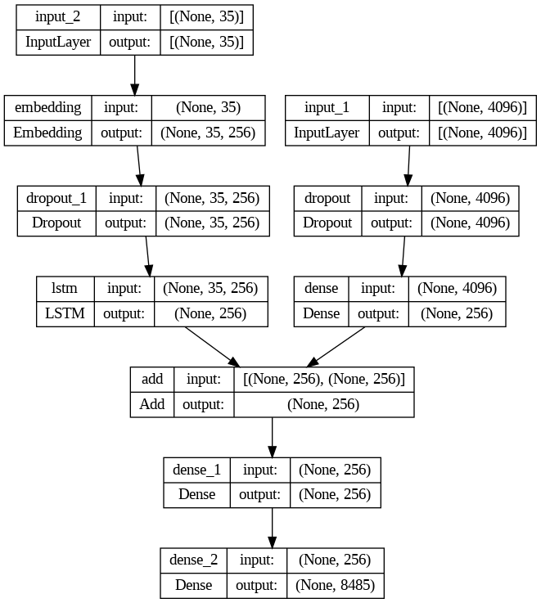
Baseline
Input: X1 (image feature),X2(in seq.)
Target: y (out seq.)
Encoder: VGG-16 (Pre-trained ImageNet) to extract image features
Decoder: LSTM to decode the next sequence token given the seq.embedding
Image encoder: extracted features+dropout+dense layer
Decoder:
Seq. processing: padded partial captions+embedding layer+dropout+lstm+sequential dependencies
Combined output: lstm and encoded img. Combined Features+dense layer+softmax layer
Training: 20 epochs, Adam opt., batch size of 32, lr. rate 0.001

Slide 9
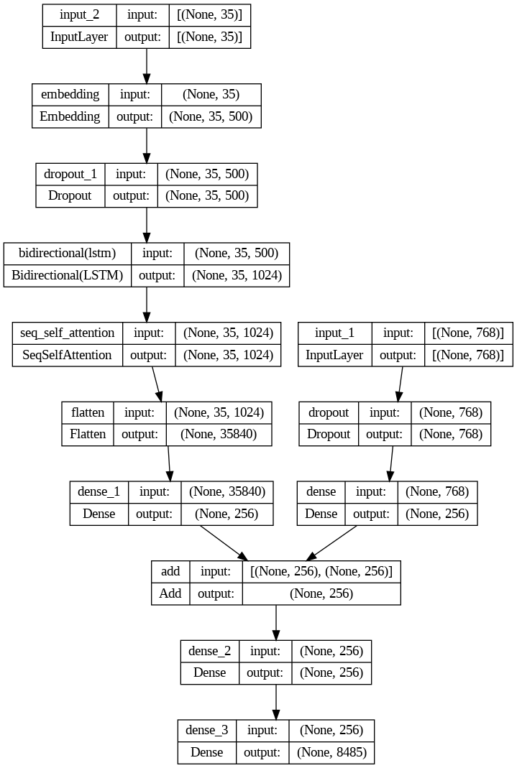
Main Approach
Input: X1 (image feature), X2(in seq.)
Target: y (out seq.)
Feature extractor: ViT b16 pretrained on ImageNet 2012.
Decoder: Bidirectional LSTM + self attention unit.
Encoder: extracted features+dropout+dense layer
Concatenation:
Concatenate layer of the two feature vectors;
Dense layer that passes the concatenation vector;
Output dense layer (output size = vocabulary size).
Inference: Greedy search within Softmax vector

Slide 10
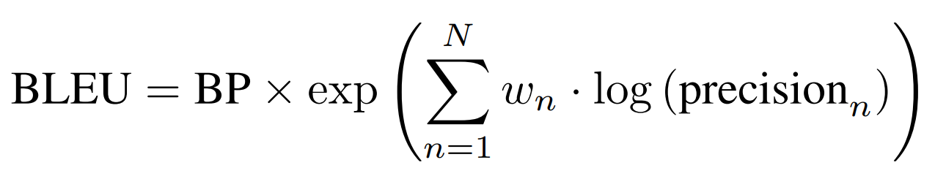
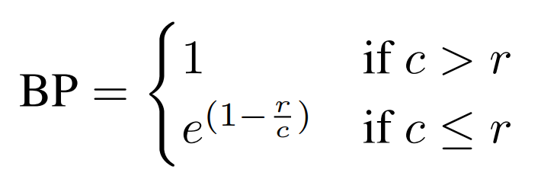
BLEU
BP is the brevity penalty, penalizing short translations.
N is the maximum order of n-grams considered.
wn is the weighting vector, which is most typically chosen to be equal 1/N
precision is the precision of n-grams, representing the ratio of the number of n-grams in the candidate that appear in at least one reference translation to the total number of n-grams in the candidate.
c is the length of the candidate corpus
r is the effective reference corpus length

Slide 11
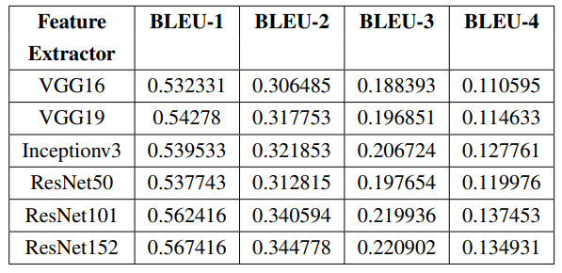
Results
Experiment 1: Pre-trained CNNs for Feature Extraction

Slide 12
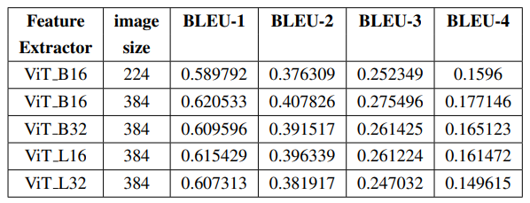
Results
Experiment 2: Pre-trained ViTs for Feature Extraction

Slide 13
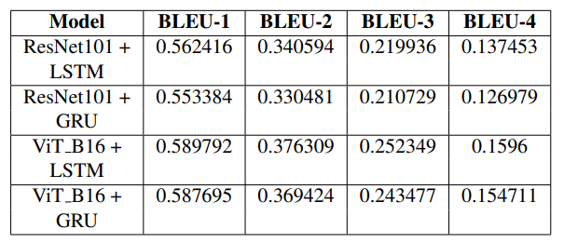
Results
Experiment 3: Changing LSTM to GRU in the Baseline Model

Slide 14
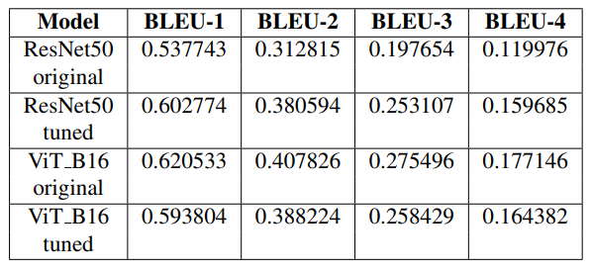
Results
Experiment 4: Changing Hyperparameters in the Baseline Model

Slide 15
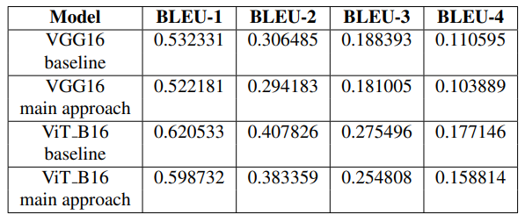
Results
Experiment 5: Baseline vs. Main Approach

Slide 16
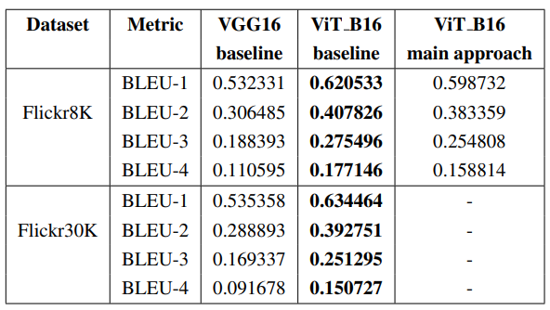
Summary of Results

Slide 17
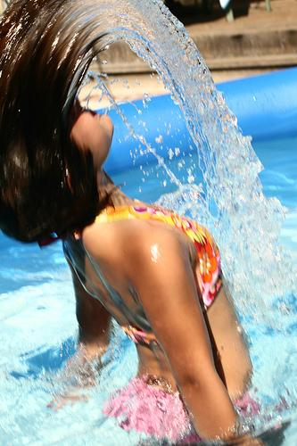
Demonstration of Results
VGG16 baseline: girl in pink swimsuit is swimming in pool
ViT_B16 baseline: girl in watermelon swimsuit plays in water
ViT_B16 main approach: girl in pink bathing suit is playing in the water
GT1: girl makes an arc of water with her hair in pool
GT2: young girl doing back flip in the water
GT3: the girl is taking her hair out of the water

Slide 18
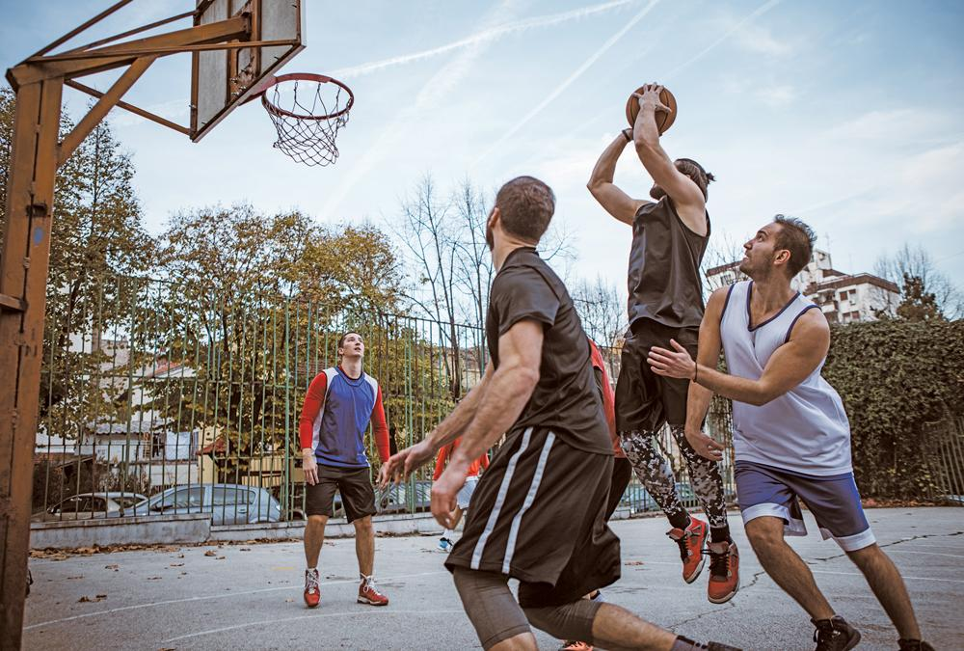
Demonstration of Results
VGG16 baseline: two girls are playing in karate game
ViT_B16 baseline: two men playing basketball
ViT_B16 main approach: two men are playing basketball

Slide 19
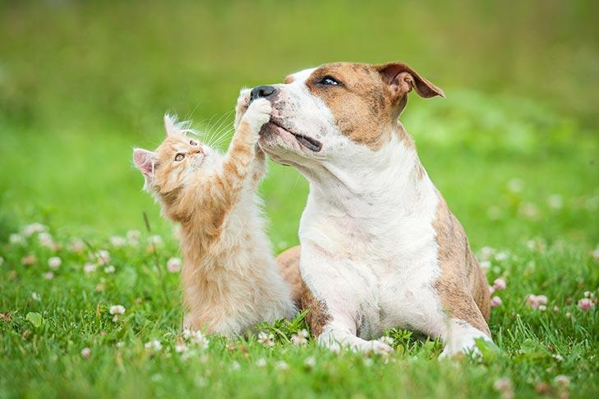
Demonstration of Results
VGG16 baseline: two white and white dogs running through the grass
ViT_B16 baseline: two dogs are playing in field

Slide 20
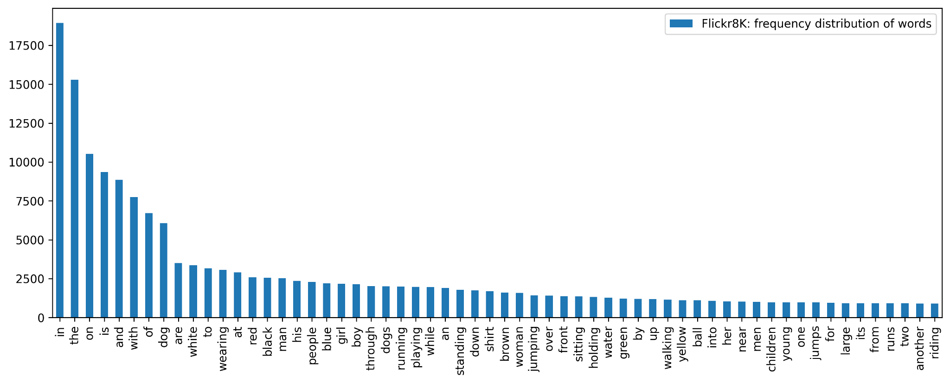
Frequency Distribution of Words in Flickr8K

Slide 21

Thanks!
Any Questions?

